Slide 1
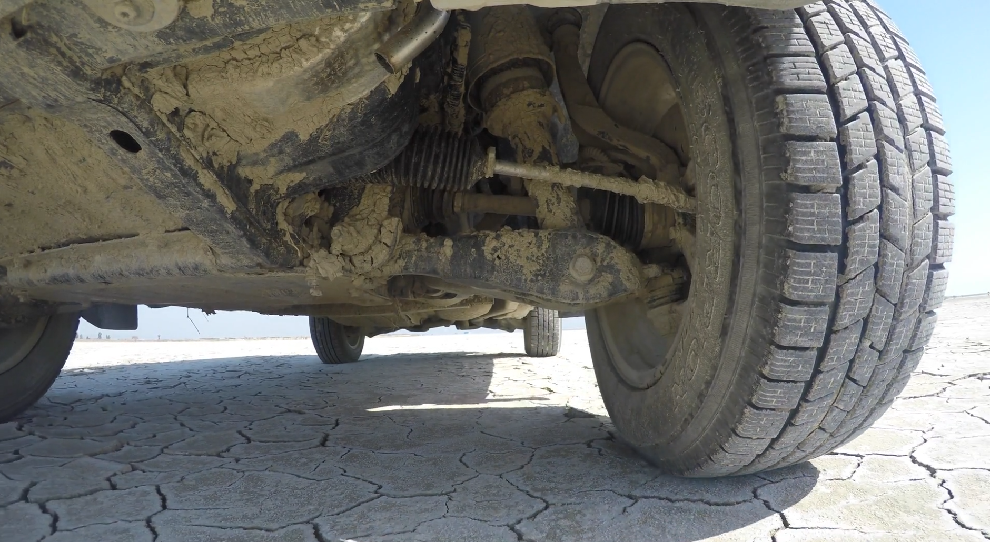
Vibration isolation
Single degree of freedom systems
Tyler Dare

Slide 2
Harmonic oscillators
Many simple vibrating systems can be represented by just two quantities:
A mass or inertia that wants to keep moving.
A spring or restoring force that prevents the mass from moving too far.

Slide 3
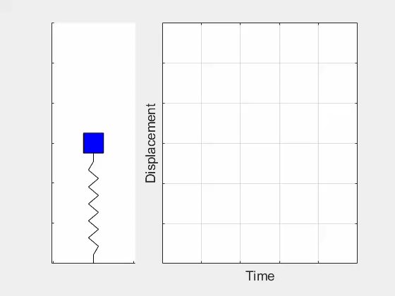
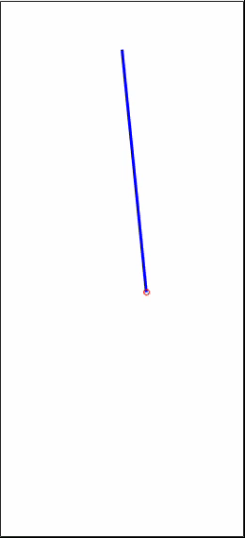
Harmonic oscillators
Many simple vibrating systems can be represented by just two quantities:
A mass or inertia that wants to keep moving.
A spring or restoring force that prevents the mass from moving too far.

Slide 4
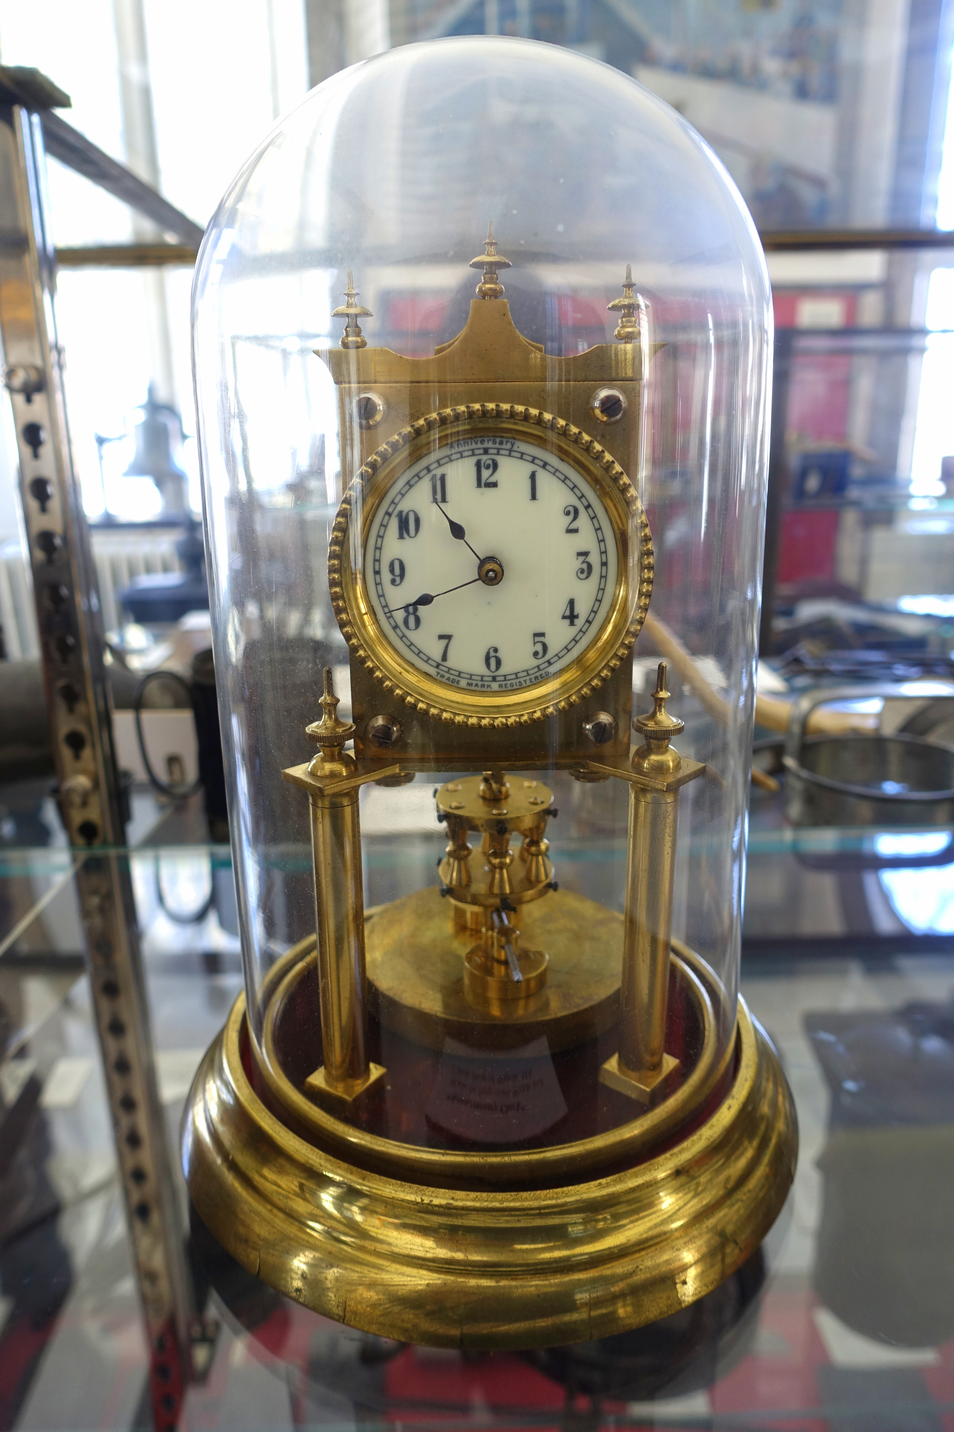
Harmonic oscillators
Many simple vibrating systems can be represented by just two quantities:
A mass or inertia that wants to keep moving.
A spring or restoring force that prevents the mass from moving too far.

Slide 5
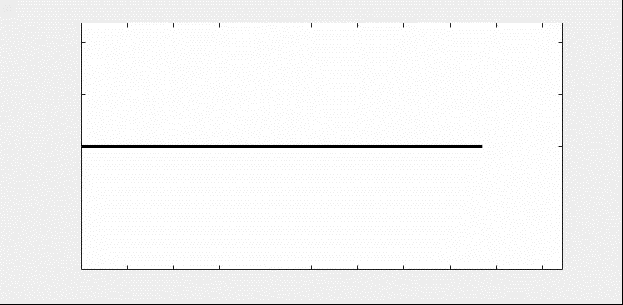
Harmonic oscillators
Many simple vibrating systems can be represented by just two quantities:
A mass or inertia that wants to keep moving.
A spring or restoring force that prevents the mass from moving too far.

Slide 6
Harmonic oscillators
Free body diagram of mass on spring:

Slide 7
Harmonic oscillators
Newton’s second law:

Slide 8
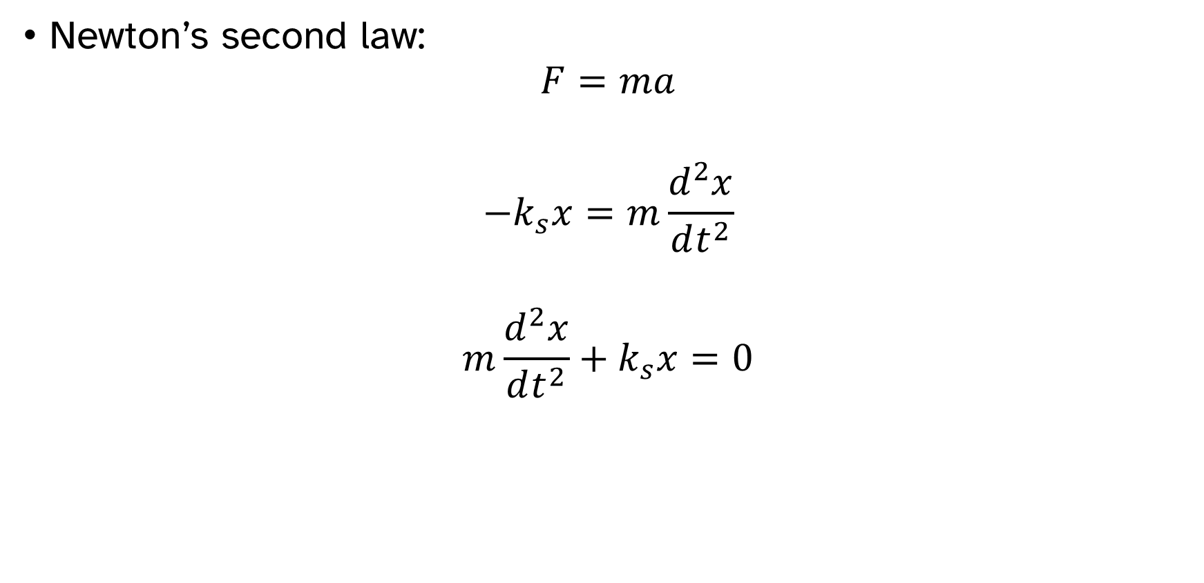
Harmonic oscillators
Newton’s second law:
$$F=ma$$
$$−k_{s}x=m\frac{d^{2}x}{dt^{2}}$$
$$m\frac{d^{2}x}{dt^{2}}+k_{s}x=0$$

Slide 9
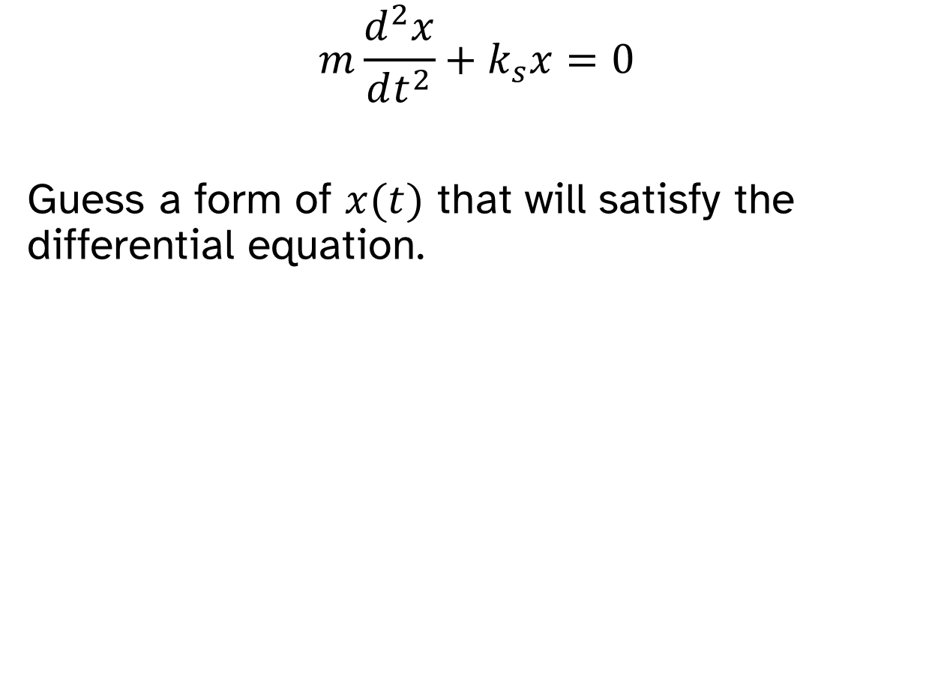
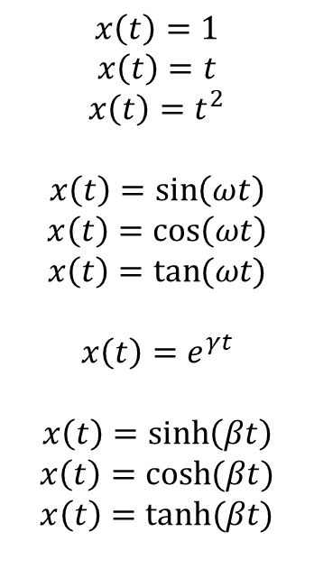
Harmonic oscillators
$$m\frac{d^{2}x}{dt^{2}}+k_{s}x=0$$
Guess a form of $x(t)$ that will satisfy the differential equation.
$$x\left(t\right)=1$$
$$x\left(t\right)=t$$
$$x\left(t\right)=t^{2}$$
$$x\left(t\right)=\sin\left(ωt\right)$$
$$x\left(t\right)=\cos\left(ωt\right)$$
$$x\left(t\right)=tan⁡(ωt)$$
$$x\left(t\right)=e^{γt}$$
$$x\left(t\right)=\sinh\left(βt\right)$$
$$x\left(t\right)=\cosh{(βt})$$
$$x\left(t\right)=tanh⁡(βt)$$

Slide 10
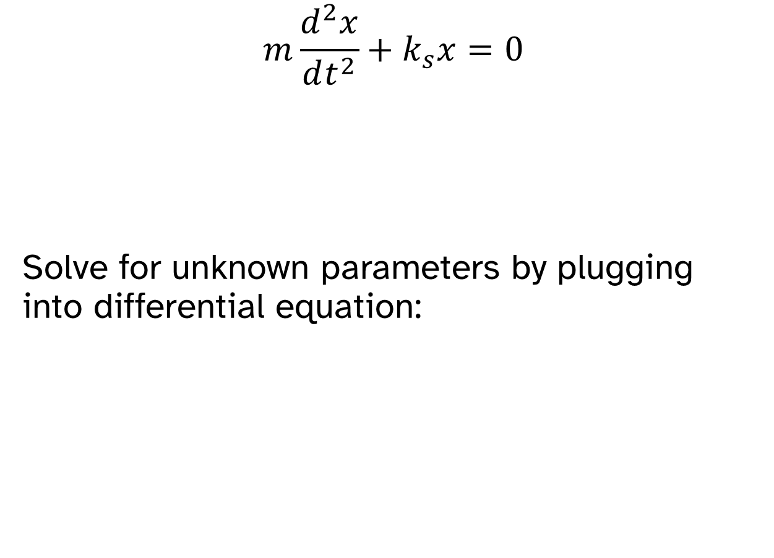
Harmonic oscillators
$$m\frac{d^{2}x}{dt^{2}}+k_{s}x=0$$
Solve for unknown parameters by plugging into differential equation:

Slide 11
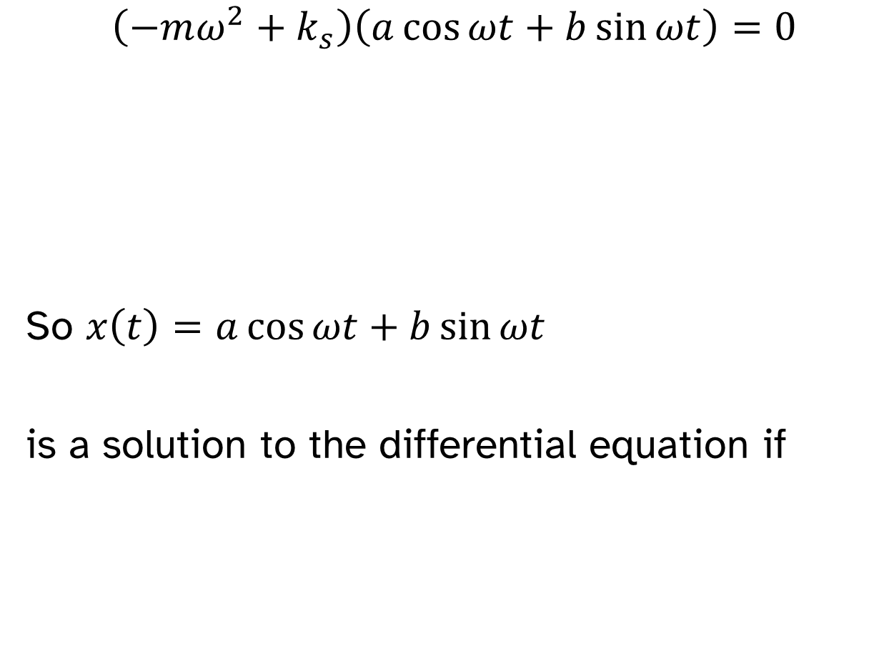
Harmonic oscillators
$$\left(−mω^{2}+k_{s}\right)\left(a\cos{ωt}+b\sin{ωt}\right)=0$$
So $x\left(t\right)=a\cos{ωt}+b\sin{ωt}$
is a solution to the differential equation if

Slide 12
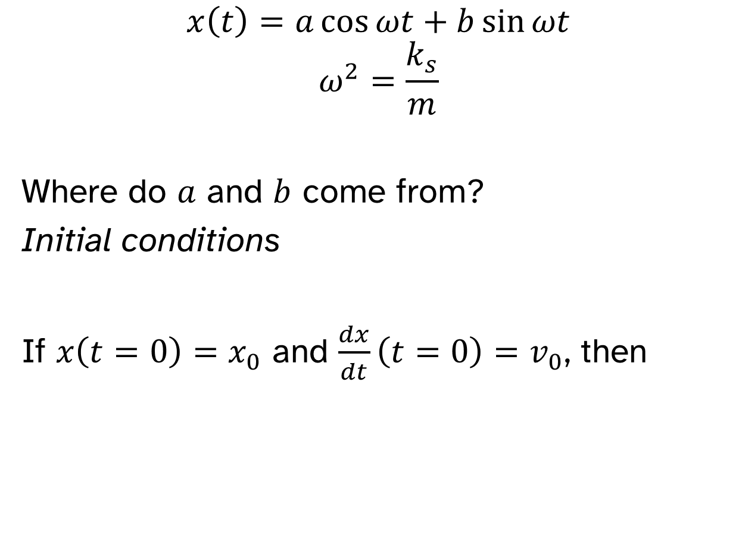
Harmonic oscillators
$$x\left(t\right)=a\cos{ωt}+b\sin{ωt}$$
$$ω^{2}=\frac{k_{s}}{m}$$
Where do $a$ and $b$ come from?
Initial conditions
If $x\left(t=0\right)=x_{0}$ and $\frac{dx}{dt}\left(t=0\right)=v_{0}$, then

Slide 13
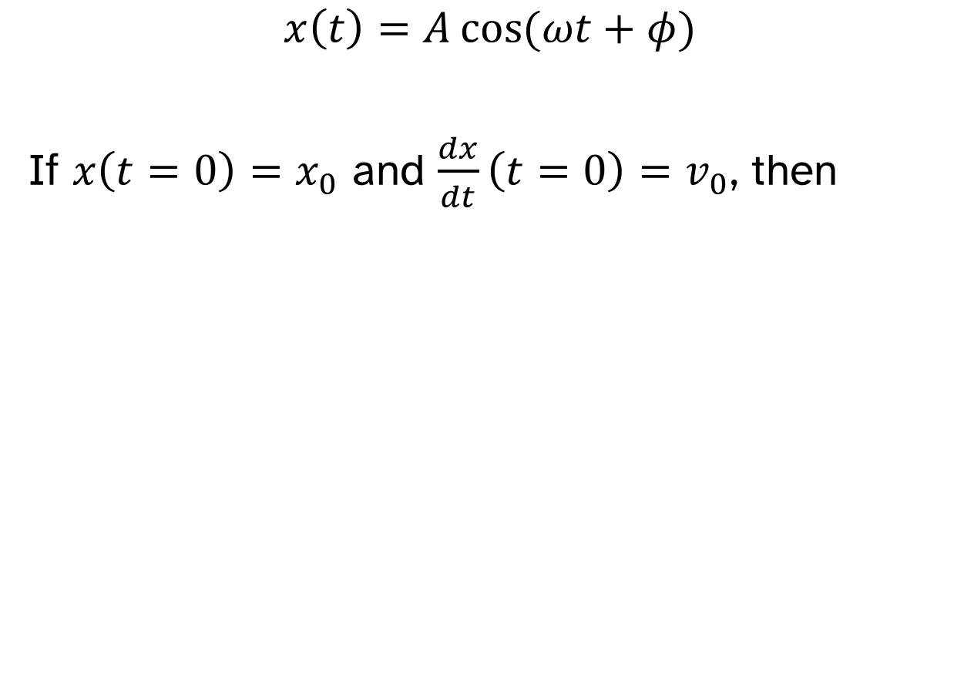
Alternative form
$$x\left(t\right)=A\cos{(ωt+φ)}$$
If $x\left(t=0\right)=x_{0}$ and $\frac{dx}{dt}\left(t=0\right)=v_{0}$, then

Slide 14
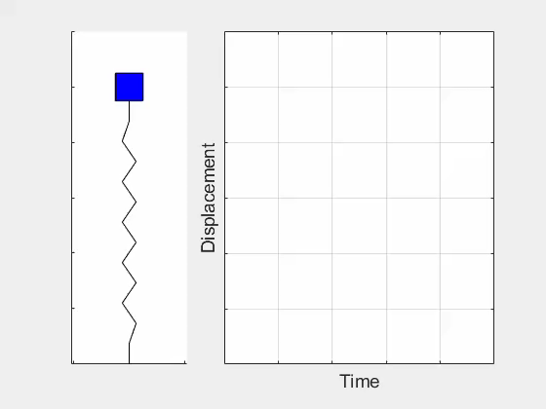

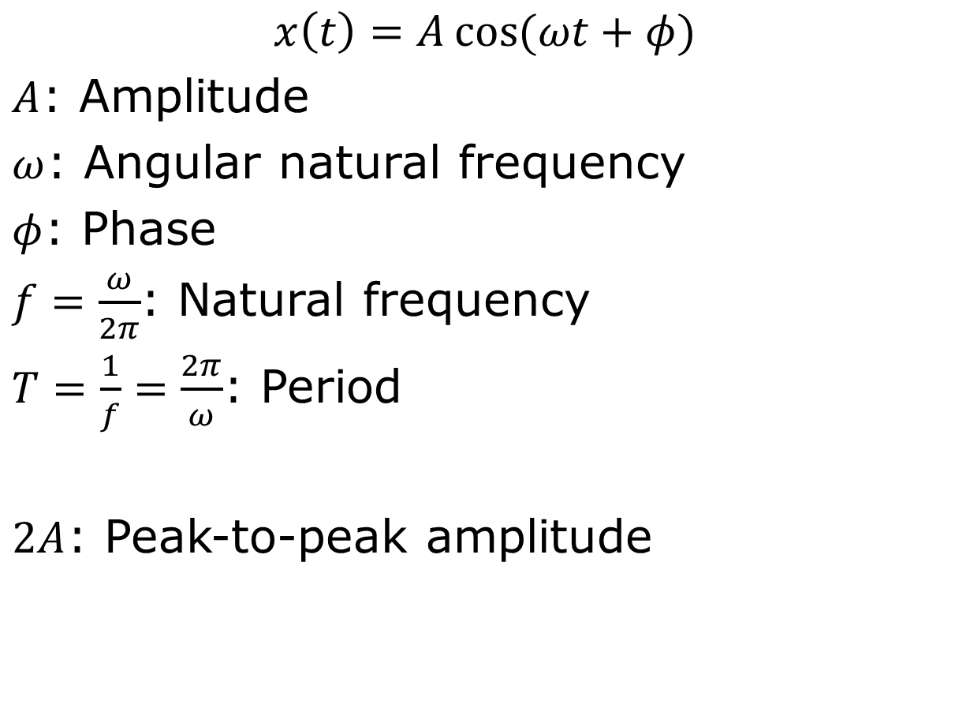

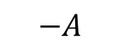
Terminology
$$x\left(t\right)=A\cos{(ωt+φ)}$$
$A$: Amplitude
$ω$: Angular natural frequency
$φ$: Phase
$f=\frac{ω}{2π}$: Natural frequency
$T=\frac{1}{f}=\frac{2π}{ω}$: Period
$2A$: Peak-to-peak amplitude
$$T$$
$$A$$
$$−A$$

Slide 15
Complex solution
$$m\frac{d^{2}x}{dt^{2}}+k_{s}x=0$$
Guess a form of $x(t)$ that will satisfy the differential equation.
$$x\left(t\right)=1$$
$$x\left(t\right)=t$$
$$x\left(t\right)=t^{2}$$
$$x\left(t\right)=\sin\left(ωt\right)$$
$$x\left(t\right)=\cos\left(ωt\right)$$
$$x\left(t\right)=tan⁡(ωt)$$
$$x\left(t\right)=e^{γt}$$
$$x\left(t\right)=\sinh\left(βt\right)$$
$$x\left(t\right)=\cosh{(βt})$$
$$x\left(t\right)=tanh⁡(βt)$$

Slide 16
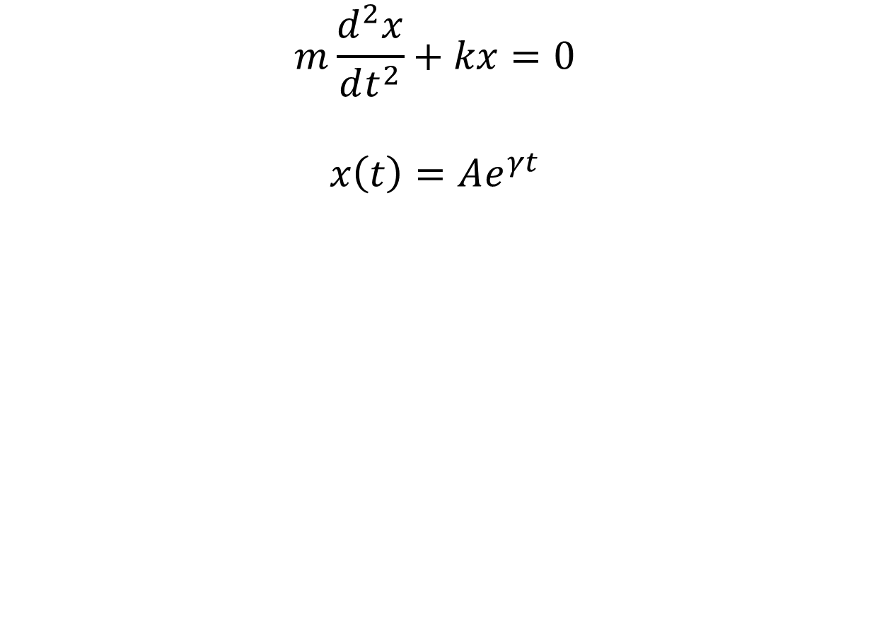
Complex solution
$$m\frac{d^{2}x}{dt^{2}}+kx=0$$
$$x\left(t\right)=Ae^{γt}$$

Slide 17
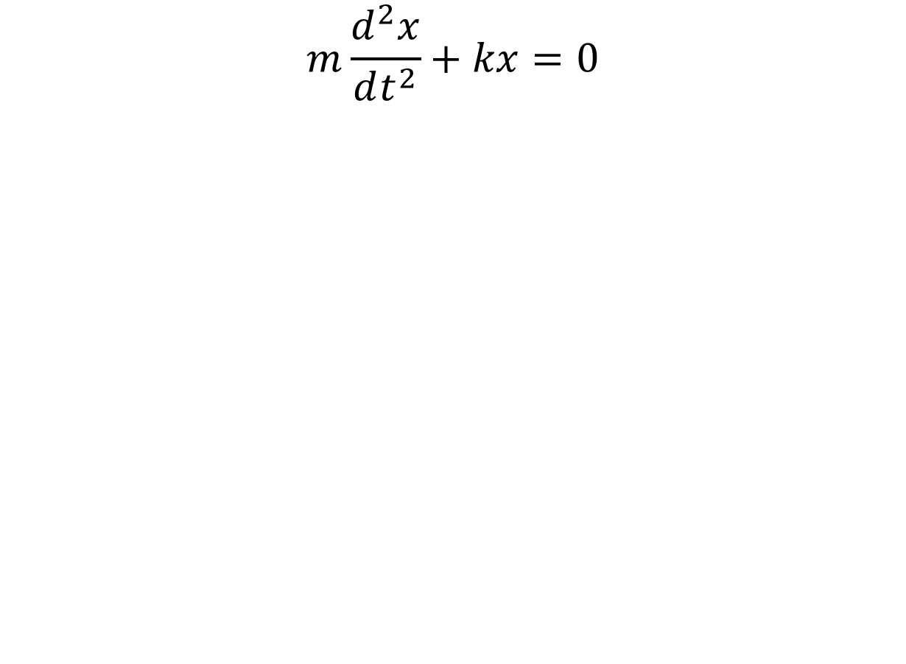
Complex solution
$$m\frac{d^{2}x}{dt^{2}}+kx=0$$

Slide 18
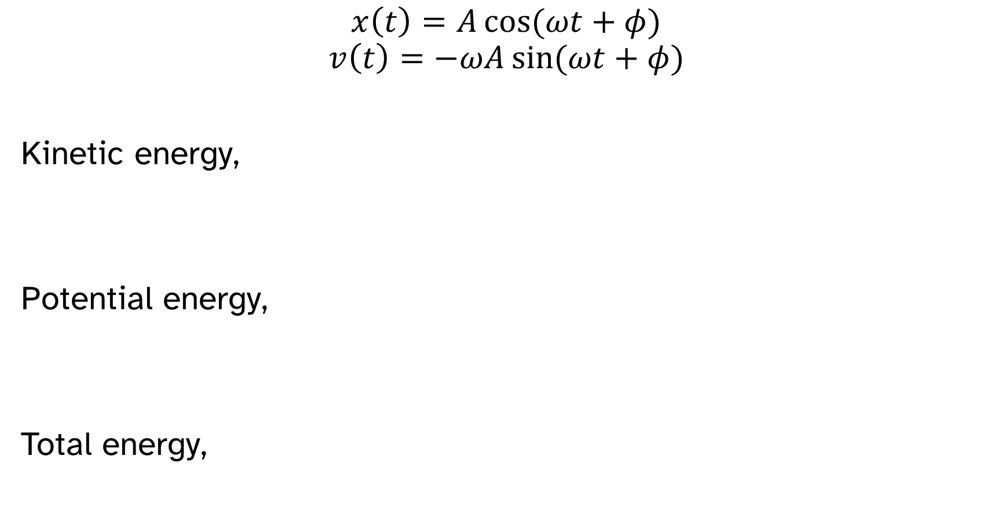
Energy
$$x\left(t\right)=A\cos{(ωt+φ)}$$
$$v\left(t\right)=−ωA\sin{(ωt+φ)}$$
Kinetic energy,
Potential energy,
Total energy,

Slide 19
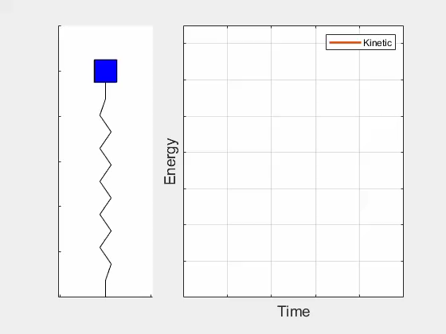
Kinetic energy

Slide 20
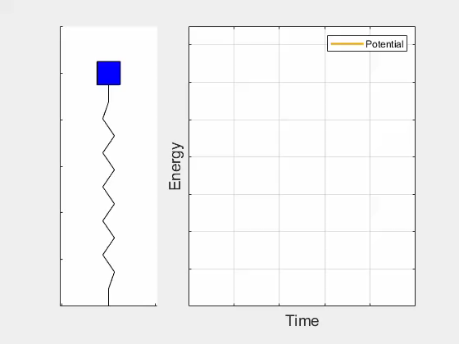
Potential energy

Slide 21
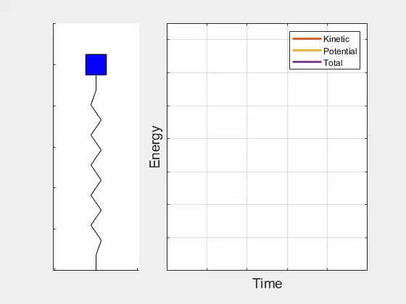
Total energy

Slide 22
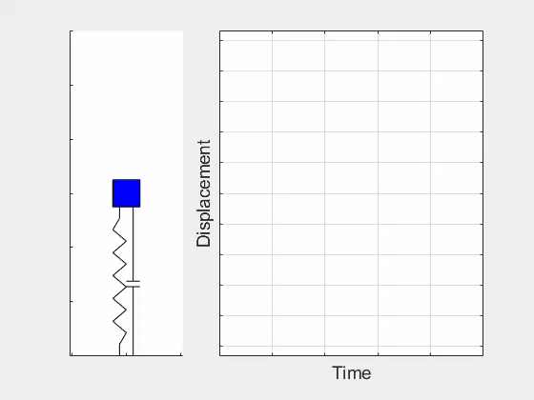
Damping

Slide 23
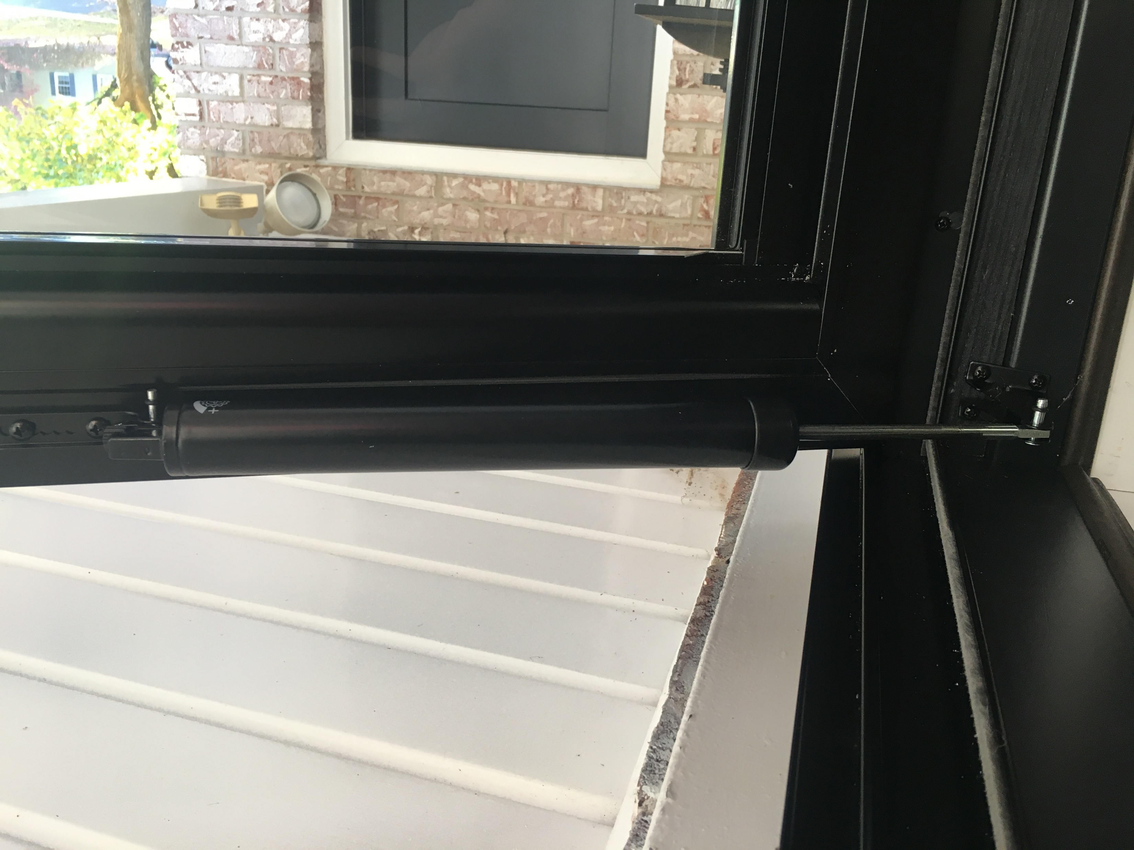
Viscous damping

Slide 24
Free body diagram with damping

Slide 25
Damped equation of motion
Newton’s second law:

Slide 26
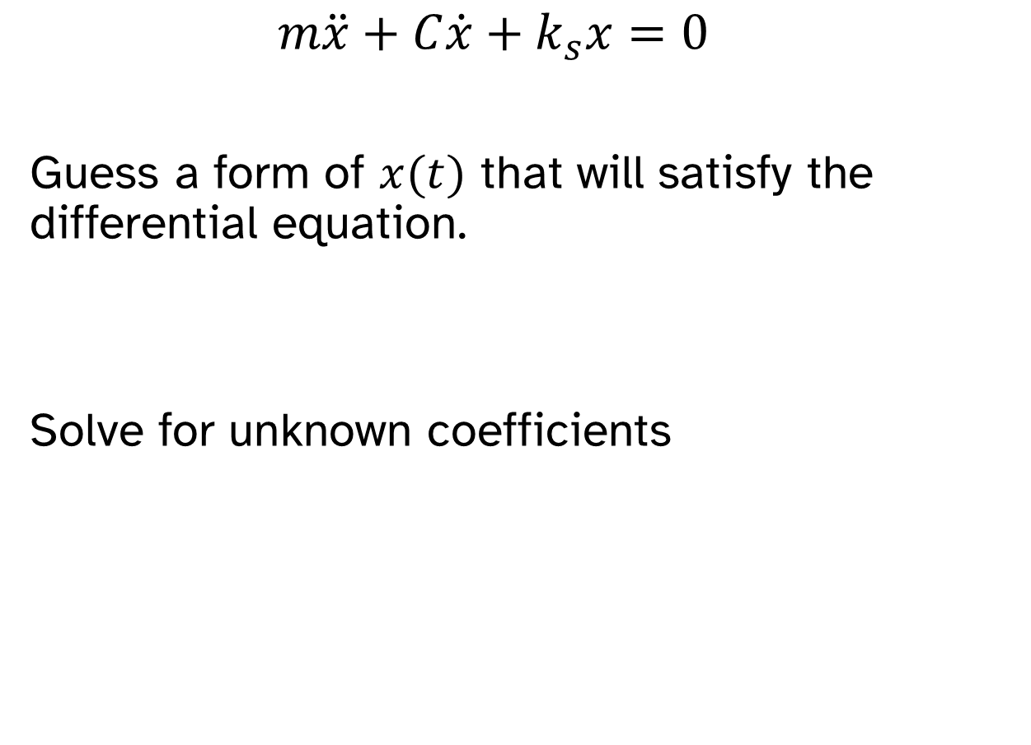
Damped oscillator solution
$$m\ddot{x}+C\dot{x}+k_{s}x=0$$
Guess a form of $x(t)$ that will satisfy the differential equation.
Solve for unknown coefficients

Slide 27
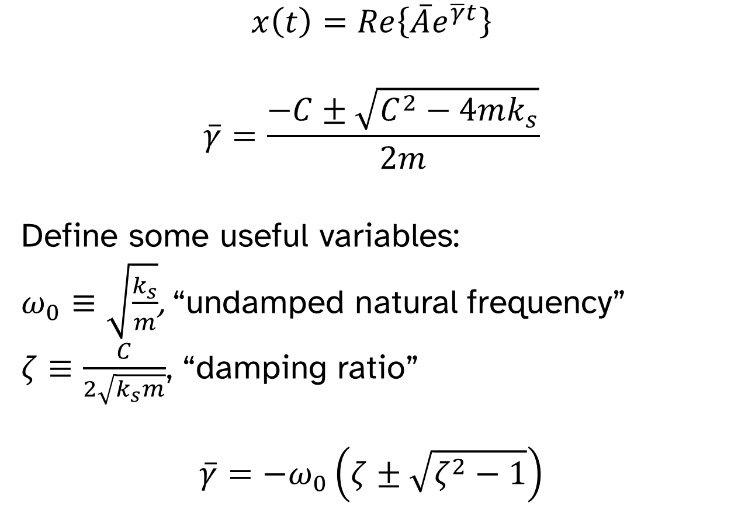
Damped oscillator solution
$$x\left(t\right)=Re\left\{\overline{A}e^{\overline{γ}t}\right\}$$
$$\overline{γ}=\frac{−C±\sqrt{C^{2}−4mk_{s}}}{2m}$$
Define some useful variables:
$ω_{0}≡\sqrt{\frac{k_{s}}{m}}$, “undamped natural frequency”
$ζ≡\frac{C}{2\sqrt{k_{s}m}}$, “damping ratio”
$$\overline{γ}=−ω_{0}\left(ζ±\sqrt{ζ^{2}−1}\right)$$

Slide 28
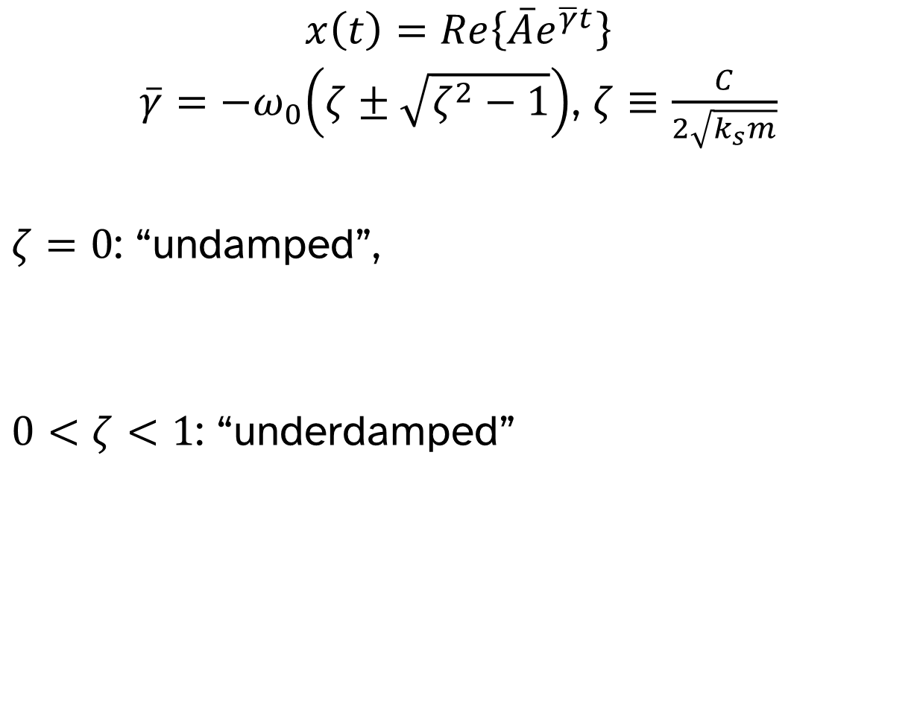
Damping regimes
$$x\left(t\right)=Re\left\{\overline{A}e^{\overline{γ}t}\right\}$$
$\overline{γ}=−ω_{0}\left(ζ±\sqrt{ζ^{2}−1}\right)$, $ζ≡\frac{C}{2\sqrt{k_{s}m}}$
$ζ=0$: “undamped”,
$0<ζ<1$: “underdamped”

Slide 29
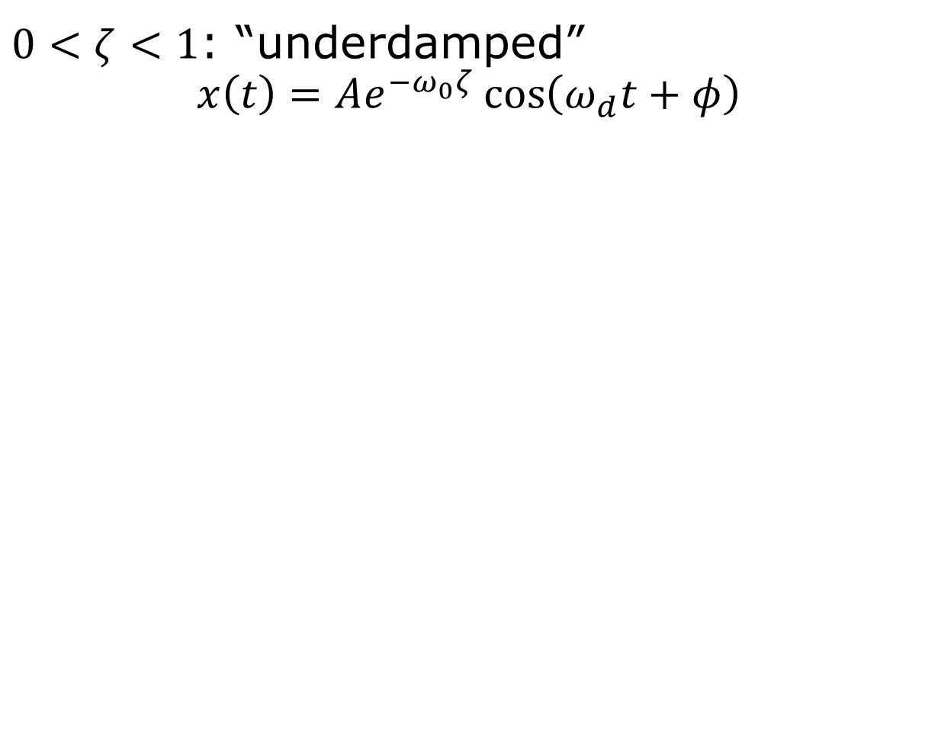
Damping regimes
$0<ζ<1$: “underdamped”
$$x\left(t\right)=Ae^{−ω_{0}ζ}\cos\left(ω_{d}t+φ\right)$$

Slide 30
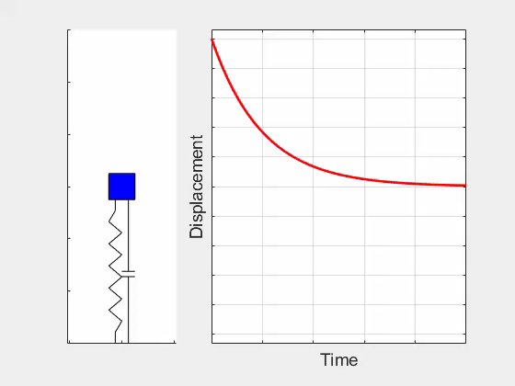
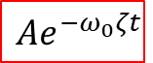
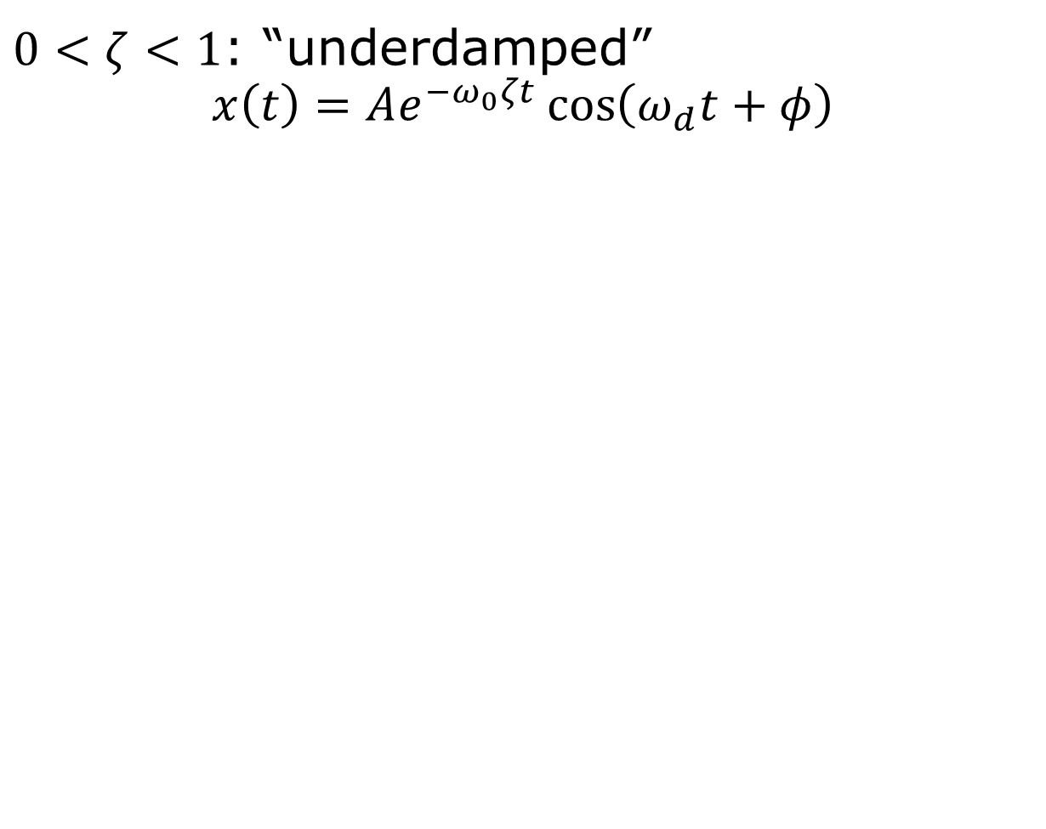
Damping regimes
$0<ζ<1$: “underdamped”
$$x\left(t\right)=Ae^{−ω_{0}ζt}\cos\left(ω_{d}t+φ\right)$$
$$Ae^{−ω_{0}ζt}$$

Slide 31
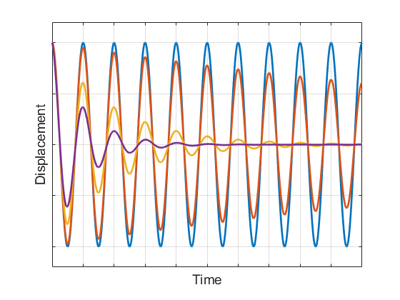
Damping regimes
$0<ζ<1$: “underdamped”
$$x\left(t\right)=Ae^{−ω_{0}ζt}\cos\left(ω_{d}t+φ\right)$$

Slide 32
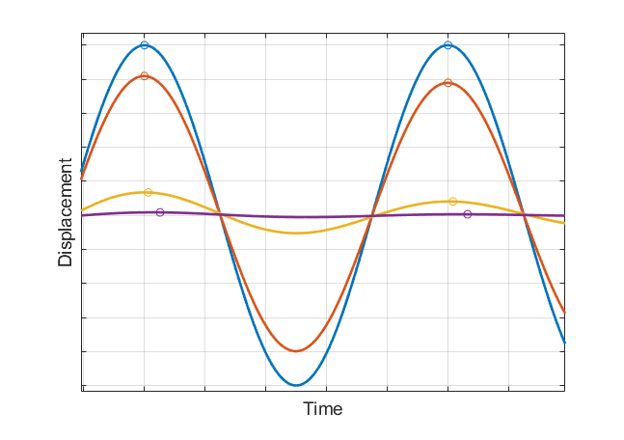
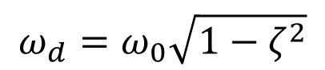
Damping regimes
$0<ζ<1$: “underdamped”
$$x\left(t\right)=Ae^{−ω_{0}ζt}\cos\left(ω_{d}t+φ\right)$$
$$ω_{d}=ω_{0}\sqrt{1−ζ^{2}}$$

Slide 33
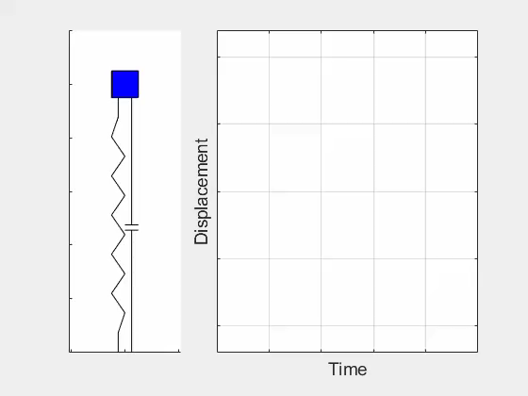
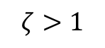
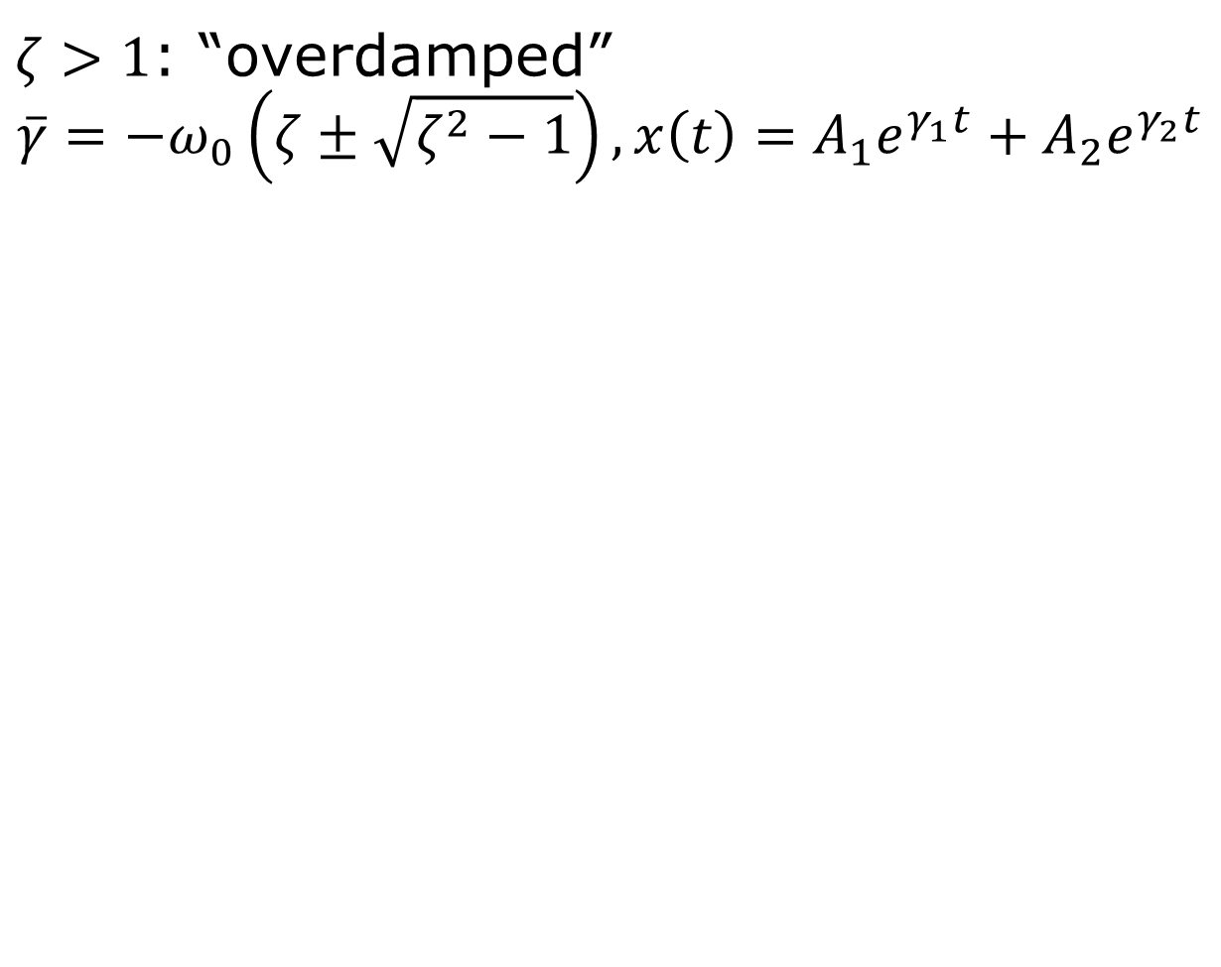
Damping regimes
$ζ>1$: “overdamped”
$$\overline{γ}=−ω_{0}\left(ζ±\sqrt{ζ^{2}−1}\right), x\left(t\right)=A_{1}e^{γ_{1}t}+A_{2}e^{γ_{2}t}$$
$$ζ>1$$

Slide 34
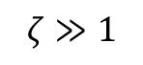
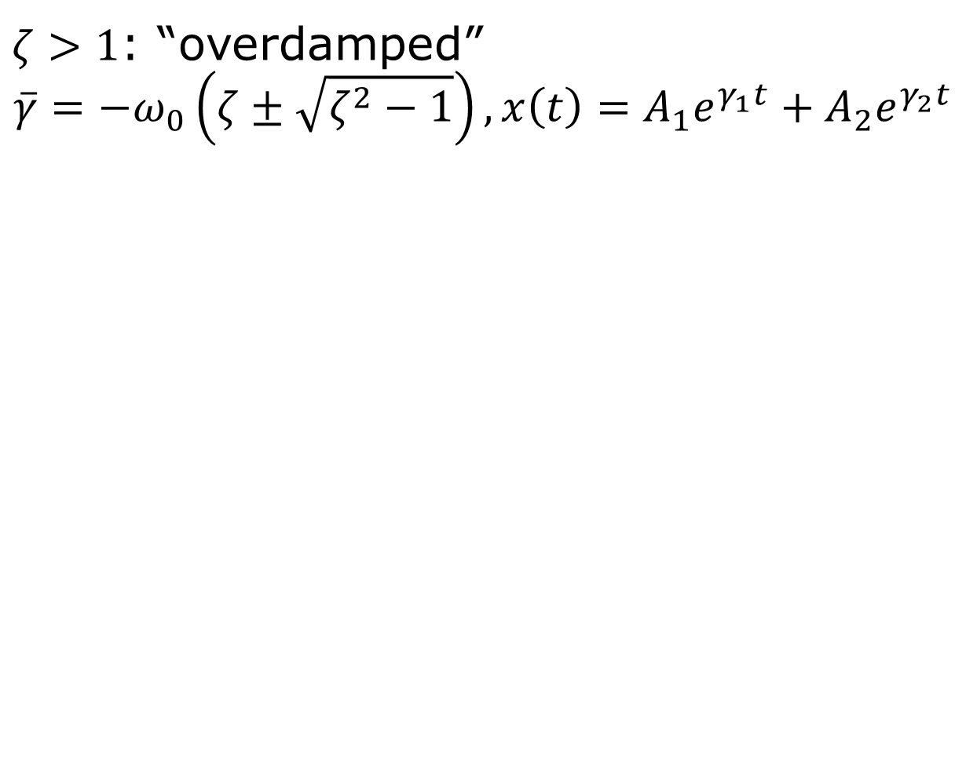
Damping regimes
$ζ>1$: “overdamped”
$$\overline{γ}=−ω_{0}\left(ζ±\sqrt{ζ^{2}−1}\right), x\left(t\right)=A_{1}e^{γ_{1}t}+A_{2}e^{γ_{2}t}$$
$$ζ≫1$$

Slide 35
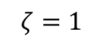
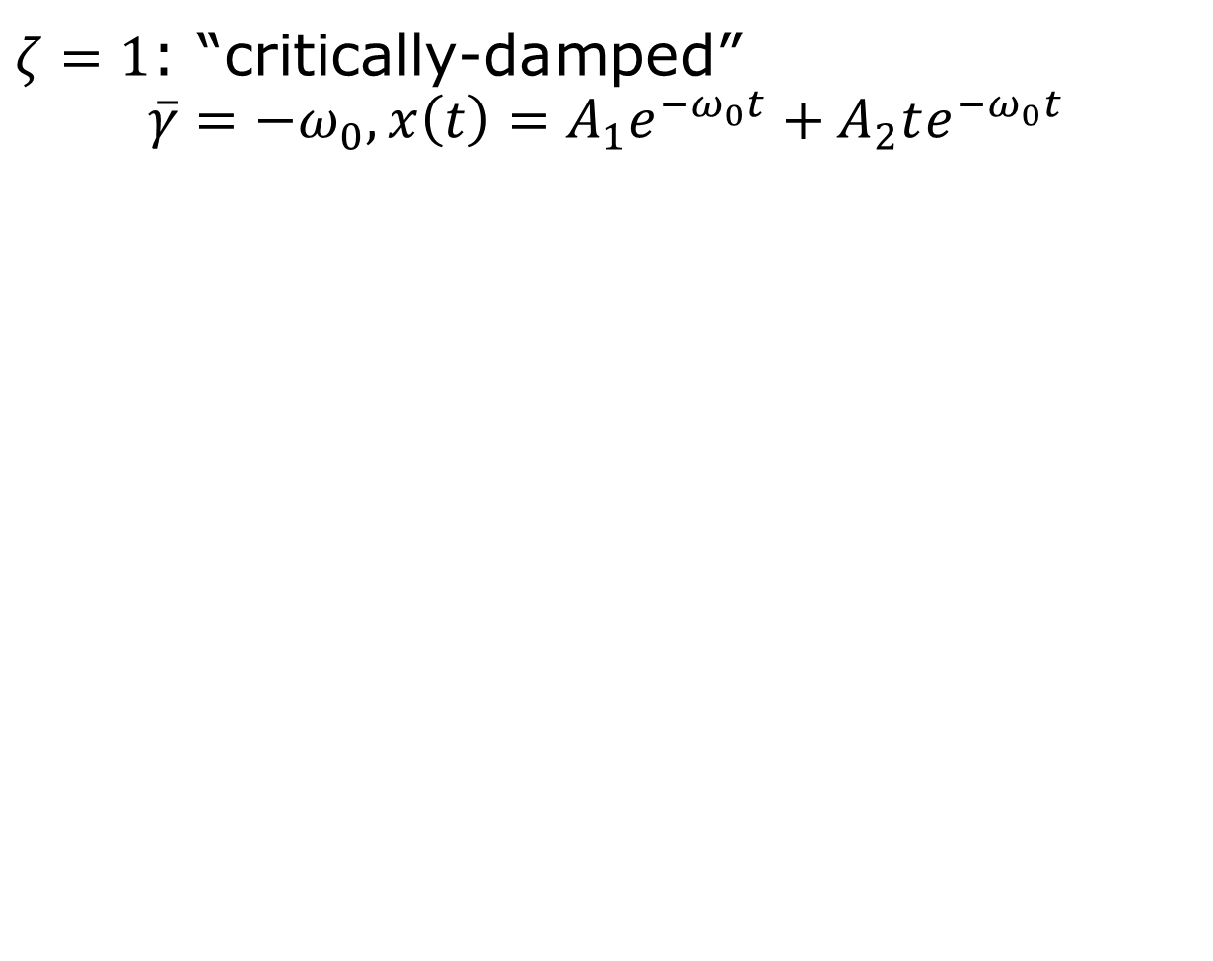
Damping regimes
$ζ=1$: “critically-damped”
$$\overline{γ}=−ω_{0}, x\left(t\right)=A_{1}e^{−ω_{0}t}+A_{2}te^{−ω_{0}t}$$
$$ζ=1$$

Slide 36
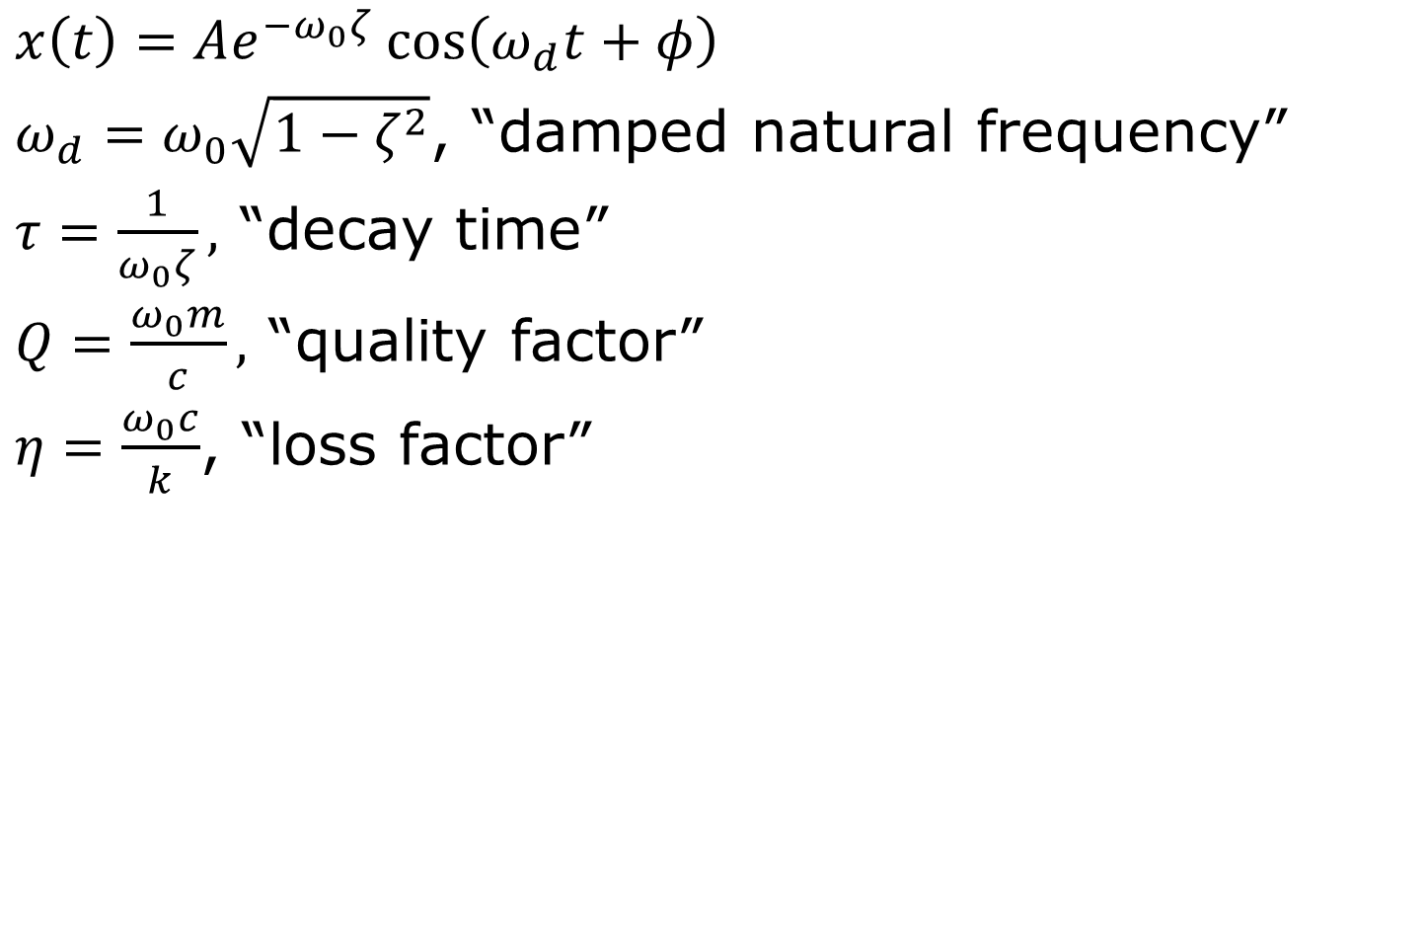
Underdamped terminology
$x\left(t\right)=Ae^{−ω_{0}ζ}\cos\left(ω_{d}t+φ\right)$
$ω_{d}=ω_{0}\sqrt{1−ζ^{2}}$, “damped natural frequency”
$τ=\frac{1}{ω_{0}ζ},$ “decay time”
$Q=\frac{ω_{0}m}{c},$ “quality factor”
$η=\frac{ω_{0}c}{k}$, “loss factor”

Slide 37
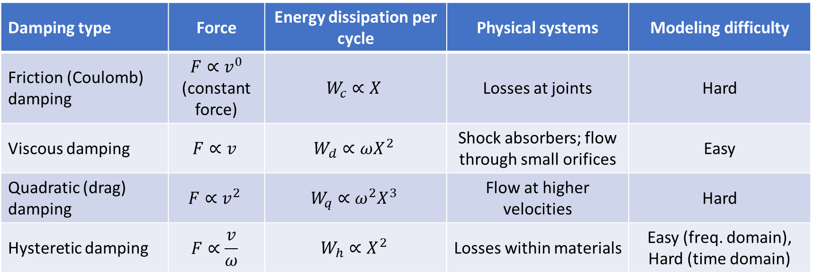
Damping models
Damping type | Force | Energy dissipation per cycle | Physical systems | Modeling difficulty
Friction (Coulomb) damping | $$F∝v^{0}$$ (constant force) | $$W_{c}∝X$$ | Losses at joints | Hard
Viscous damping | $$F∝v$$ | $$W_{d}∝ωX^{2}$$ | Shock absorbers; flow through small orifices | Easy
Quadratic (drag) damping | $$F∝v^{2}$$ | $$W_{q}∝ω^{2}X^{3}$$ | Flow at higher velocities | Hard
Hysteretic damping | $$F∝\frac{v}{ω}$$ | $$W_{h}∝X^{2}$$ | Losses within materials | Easy (freq. domain), Hard (time domain)

Slide 38
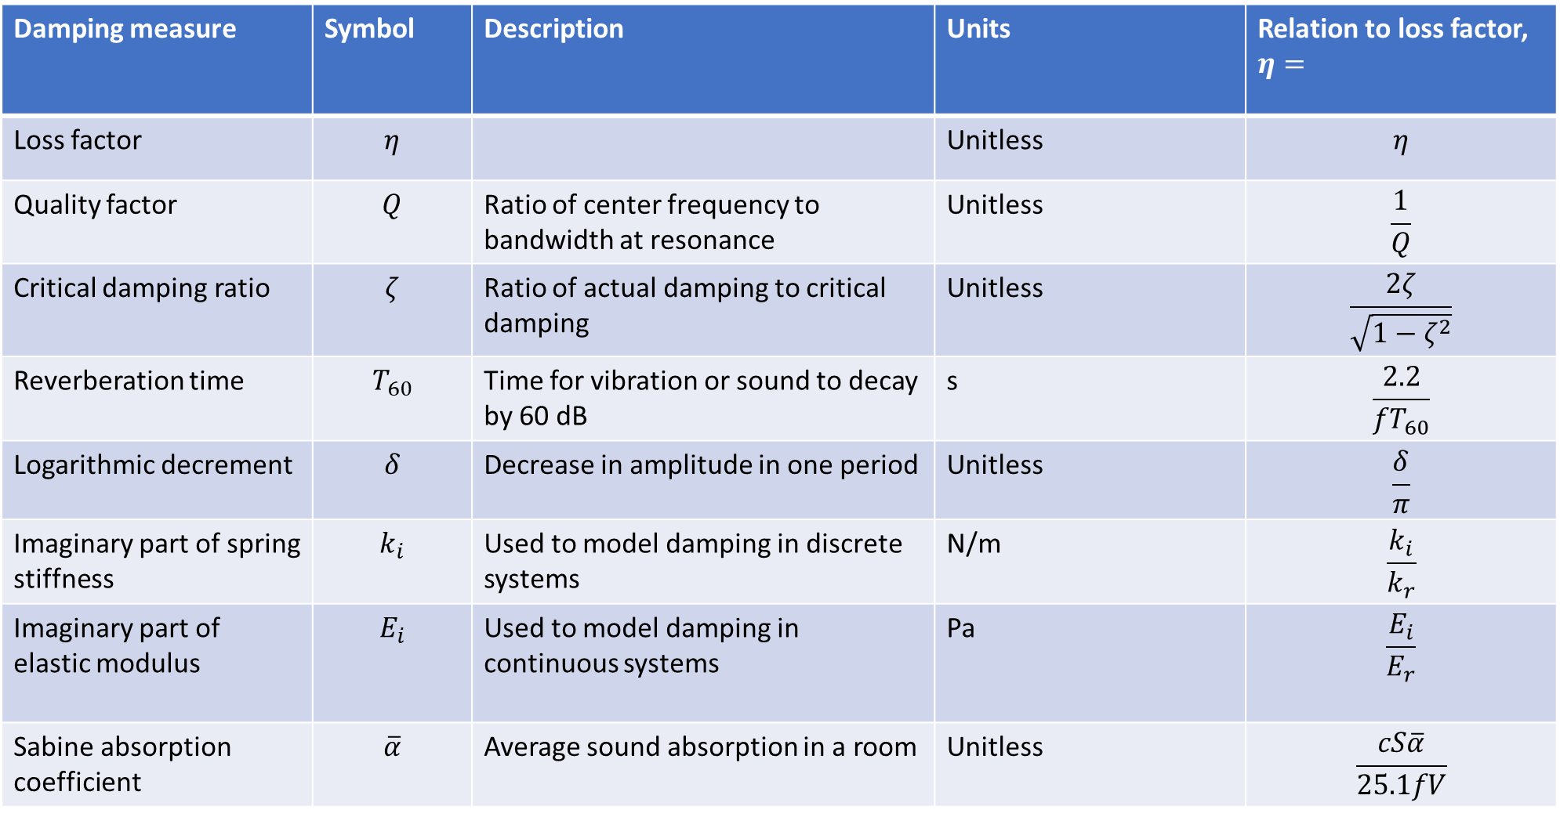
Damping descriptors
Damping measure | Symbol | Description | Units | Relation to loss factor, $η=$
Loss factor | $$η$$ |  | Unitless | $$η$$
Quality factor | $$Q$$ | Ratio of center frequency to bandwidth at resonance | Unitless | $$\frac{1}{Q}$$
Critical damping ratio | $$ζ$$ | Ratio of actual damping to critical damping | Unitless | $$\frac{2ζ}{\sqrt{1−ζ^{2}}}$$
Reverberation time | $$T_{60}$$ | Time for vibration or sound to decay by 60 dB | s | $$\frac{2.2}{fT_{60}}$$
Logarithmic decrement | $$δ$$ | Decrease in amplitude in one period | Unitless | $$\frac{δ}{π}$$
Imaginary part of spring stiffness | $$k_{i}$$ | Used to model damping in discrete systems | N/m | $$\frac{k_{i}}{k_{r}}$$
Imaginary part of elastic modulus | $$E_{i}$$ | Used to model damping in continuous systems | Pa | $$\frac{E_{i}}{E_{r}}$$
Sabine absorption coefficient | $$\overline{α}$$ | Average sound absorption in a room | Unitless | $$\frac{cS\overline{α}}{25.1fV}$$

Slide 39
Energy in undamped systems

Slide 40
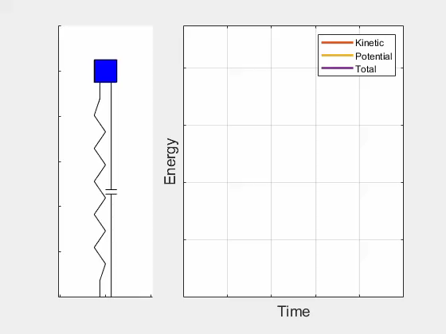
Energy in underdamped systems

Slide 41
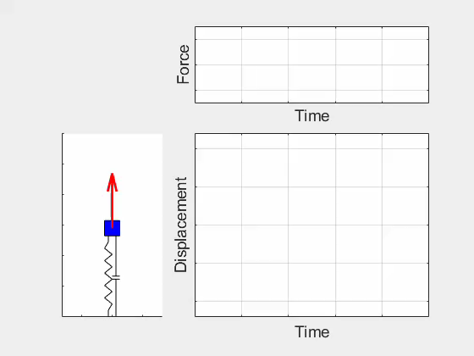
Forced oscillator

Slide 42
Free body diagram with damping and forcing

Slide 43
Forced equation of motion
Newton’s second law:

Slide 44
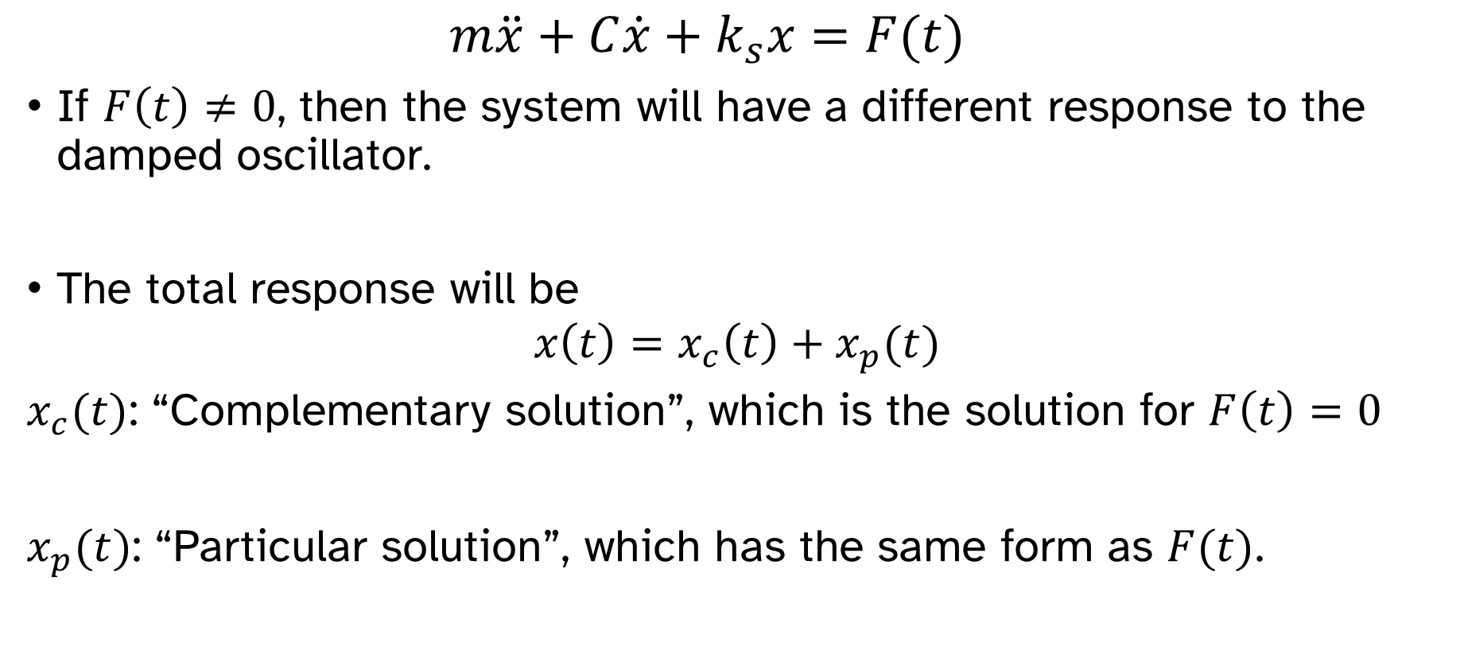
Forced oscillations
$$m\ddot{x}+C\dot{x}+k_{s}x=F(t)$$
If $F\left(t\right)≠0$, then the system will have a different response to the damped oscillator.
The total response will be
$$x\left(t\right)=x_{c}\left(t\right)+x_{p}(t)$$
$x_{c}(t)$: “Complementary solution”, which is the solution for $F\left(t\right)=0$
$x_{p}(t)$: “Particular solution”, which has the same form as $F(t)$.

Slide 45
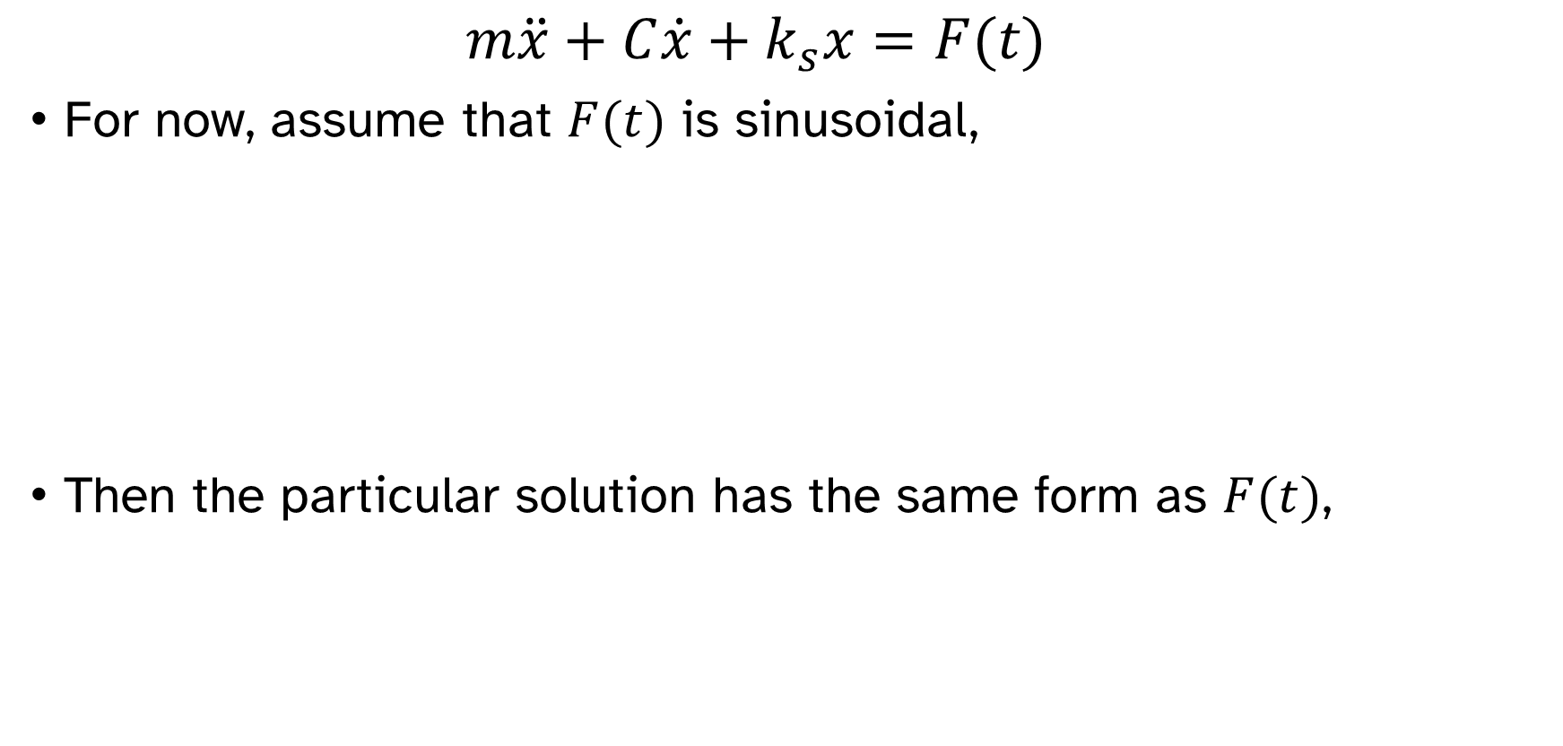
Forced oscillations
$$m\ddot{x}+C\dot{x}+k_{s}x=F(t)$$
For now, assume that $F(t)$ is sinusoidal,
Then the particular solution has the same form as $F(t)$,

Slide 46
Forced oscillations

Slide 47
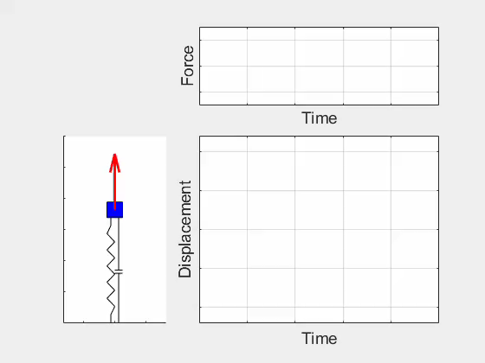
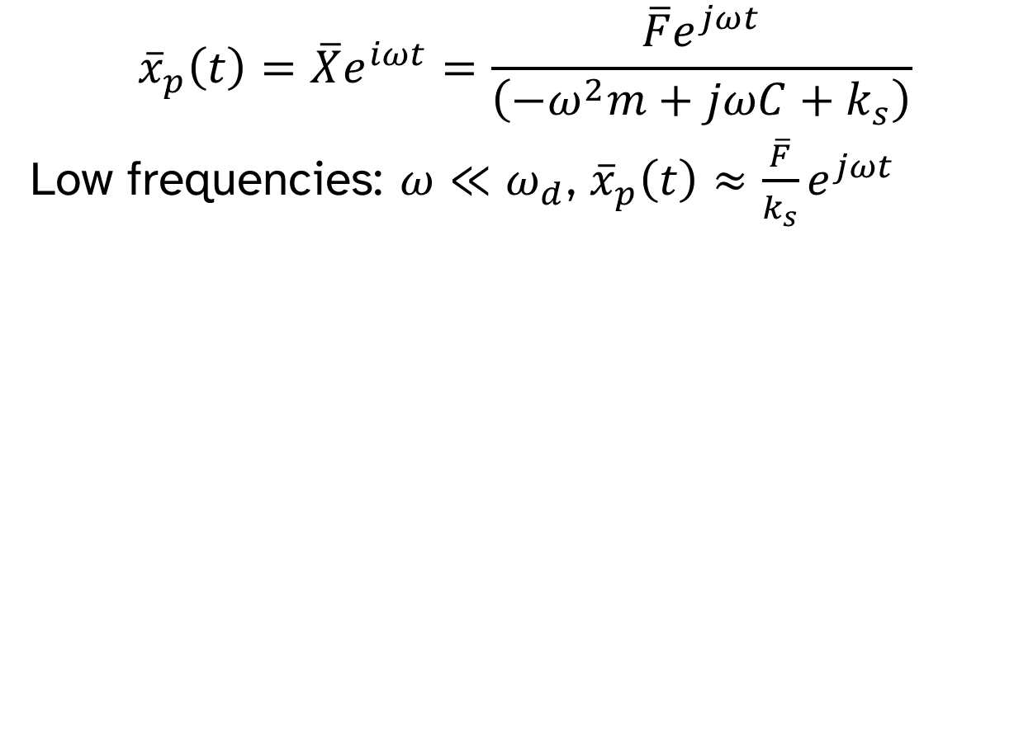
Forced oscillations
$${\overline{x}}_{p}\left(t\right)=\overline{X}e^{iωt}=\frac{\overline{F}e^{jωt}}{\left(−ω^{2}m+jωC+k_{s}\right)}$$
Low frequencies: $ω≪ω_{d}$, ${\overline{x}}_{p}\left(t\right)≈\frac{\overline{F}}{k_{s}}e^{jωt}$

Slide 48

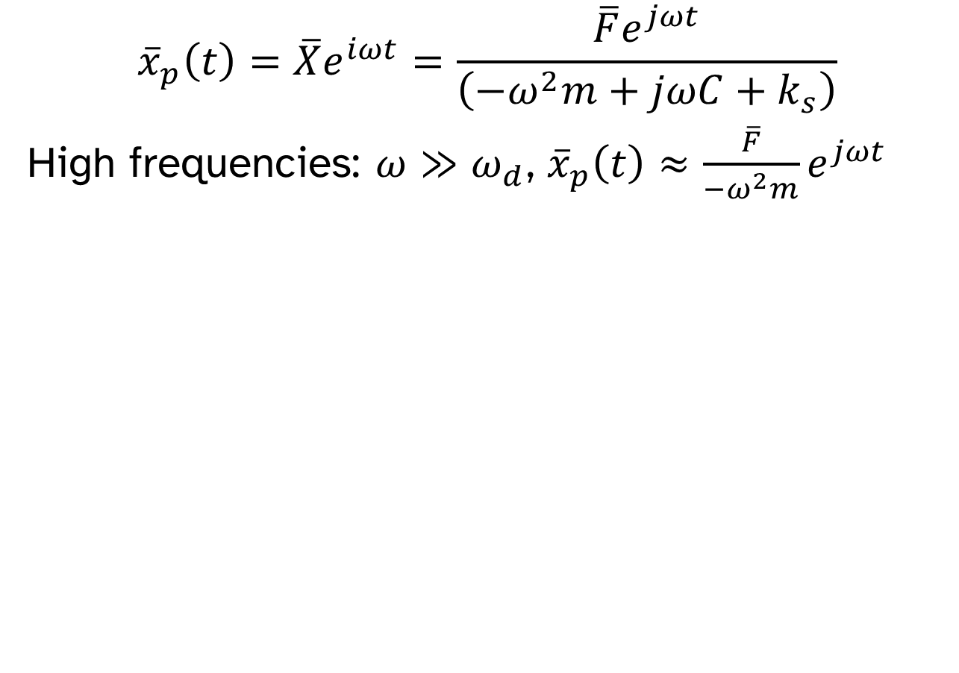
Forced oscillations
$${\overline{x}}_{p}\left(t\right)=\overline{X}e^{iωt}=\frac{\overline{F}e^{jωt}}{\left(−ω^{2}m+jωC+k_{s}\right)}$$
High frequencies: $ω≫ω_{d}$, ${\overline{x}}_{p}\left(t\right)≈\frac{\overline{F}}{−ω^{2}m}e^{jωt}$

Slide 49

Forced oscillations
$${\overline{x}}_{p}\left(t\right)=\overline{X}e^{iωt}=\frac{\overline{F}e^{jωt}}{\left(−ω^{2}m+jωC+k_{s}\right)}$$
Near resonance: $ω≈ω_{d}$, ${\overline{x}}_{p}\left(t\right)≈\frac{\overline{F}}{jωc}e^{jωt}$

Slide 50

Frequency response functions
$${\overline{x}}_{p}\left(t\right)=\overline{X}e^{iωt}=\frac{\overline{F}e^{jωt}}{\left(−ω^{2}m+jωC+k_{s}\right)}$$
$$\frac{\overline{X}}{\overline{F}}=\frac{1}{\left(−ω^{2}m+jωC+k_{s}\right)}$$
“Admittance”
$$\frac{\overline{A}}{\overline{F}}=\frac{−ω^{2}\overline{X}}{\overline{F}}=\frac{1}{\left(m+\frac{C}{jω}−\frac{k_{s}}{ω^{2}}\right)}$$
“Accelerance”

Slide 51
Frequency response functions

Slide 52
Frequency response functions

Slide 53
Frequency response functions

Slide 54
Frequency response functions

Slide 55



Frequency response functions
Displacement, ${\overline{x}}_{p}\left(t\right)=\overline{X}e^{jωt}$
Velocity, ${\overline{v}}_{p}\left(t\right)=\overline{V}e^{jωt}=jω\overline{X}e^{jωt}$
Acceleration, ${\overline{a}}_{p}\left(t\right)=\overline{A}e^{jωt}=−ω^{2}\overline{X}e^{jωt}$
FRF | Name
$$\frac{\overline{X}}{\overline{F}}$$ | Admittance/ Receptance/ Compliance
$$\frac{\overline{V}}{\overline{F}}$$ | Mobility
$$\frac{\overline{A}}{\overline{F}}$$ | Accelerance/ Inertance
FRF | Name
$$\frac{\overline{F}}{\overline{X}}$$ | Dynamic stiffness
$$\frac{\overline{F}}{\overline{V}}$$ | Mechanical impedance
$$\frac{\overline{F}}{\overline{A}}$$ | Dynamic mass/ Apparent mass

Slide 57
Base excitation
Instead of forcing the mass, we can model the base as moving.

Slide 58
Base excitation
If a force is applied to a machine, how much force is transmitted to the base?

Slide 59

Transmissibilities for single-stage isolators
$$\frac{{\overline{F}}_{B}}{\overline{F}}=\frac{jωC+k_{s}}{−mω^{2}+jωC+k_{s}}=\frac{\overline{X}}{{\overline{X}}_{B}}=\frac{\overline{V}}{{\overline{V}}_{B}}=\frac{\overline{A}}{{\overline{A}}_{B}}$$
$$T_{F}=\frac{{|\overline{F}}_{B}|}{\left|\overline{F}\right|}=\frac{\left|jωC+k_{s}\right|}{\left|−mω^{2}+jωC+k_{s}\right|}=\sqrt{\frac{1+{\left(2ζr\right)}^{2}}{{\left(1−r^{2}\right)}^{2}+{\left(2ζr\right)}^{2}}}$$
$$r=\frac{ω}{ω_{0}}=\frac{f}{f_{0}}$$
$$ζ=\frac{C}{2\sqrt{k_{s}m}}$$

Slide 60
Transmissibilities for single-stage isolators

